Slide 1


Machine Learning for Reservoir Inflow Temperature Prediction in water resources management models
WORLD ENVIRONMENTAL & WATER RESOURCES CONGRESS
MINNEAPOLIS, MINNESOTA| JUNE 3–7, 2018
ELLIE WHITE, Graduate Student, elawhite@ucdavis.edu
JOHN DEGEORGE, Principal & Project Manager at RMA, jfdegeorge@rmanet.com
DONALD SMITH, President at RMA, don@rmanet.com
STEPHEN ANDREWS, Senior Water Resources Engineer at RMA, steve@rmanet.com
This material is based upon work partly supported by the NSF GRFP under Grant No. 1650042 & the Climate Change, Water, and Society NSF IGERT, to UC Davis DGE No. 1069333.
Any opinion, findings, and conclusions or recommendations expressed in this material are those of the authors(s) and do not necessarily reflect the views of the National Science Foundation.
Notes:
Name,
Collaborators

Slide 2
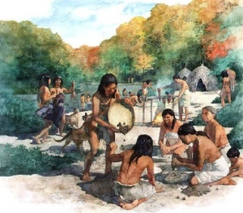
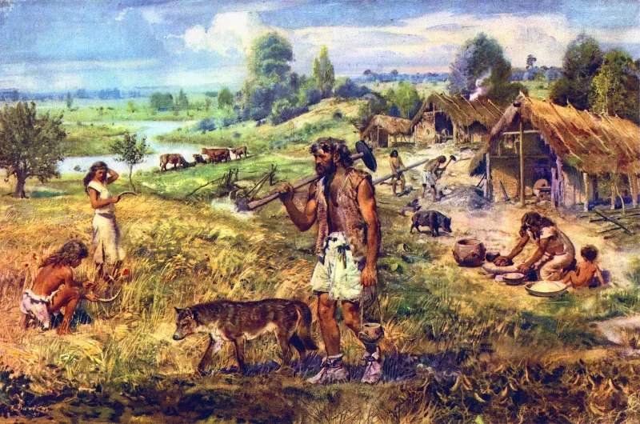
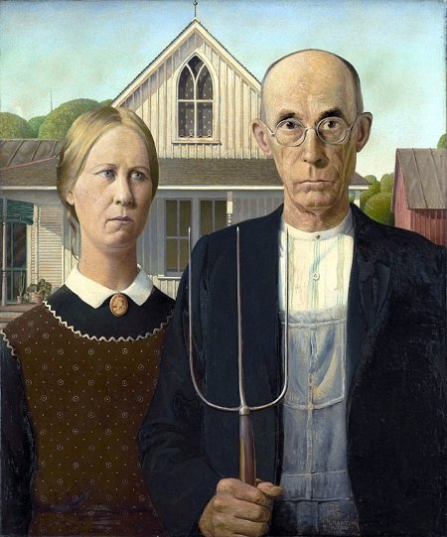
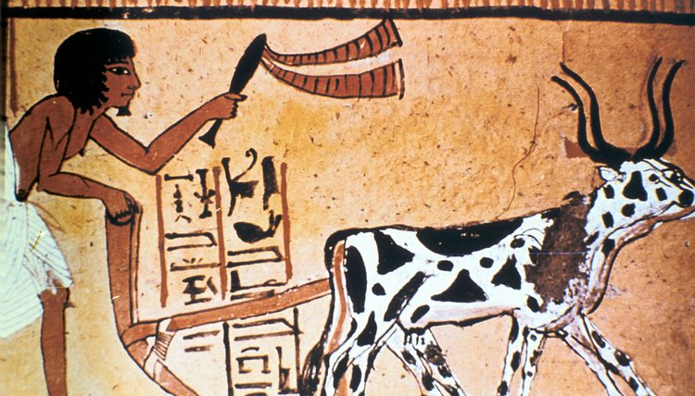

Why machine learning?
The history of humans can be explained in a quest to be calorie efficient –Stephen Fry’s Great Leap Years (Podcast, Ep.1)
Aim: predict the hourly streamflow temperatures with empirical (statistical) models rather than mechanistic (process-based) models.
Notes:
The history of humans can be explained in a quest to be calorie efficient. We went from foraging to farming, going from mobility to sedentism. More calorie efficient. When farming, we learned how to use tools, more calorie efficient. Then we outsourced our physical labor to animals. And now we are outsourcing our mental labor and more to the point decision making to computers.
So our aim is to predict streamflow temperatures with machine learned models.

Slide 3


What is machine (!) learning?
The machine isn’t learning.
We are learning, but need a machine to do it.
Research question:
1) How well can it do?
2) Which variables are really important?
Notes:
So I’m not talking about artificial intelligence as in westworld. Awesome show.
I am more referring to lots of machines crunching away.
Q1) Can machine-learning models give good streamflow temperature predictions?
Q2) What will be the relative importance of variables that contribute to this prediction?

Slide 4
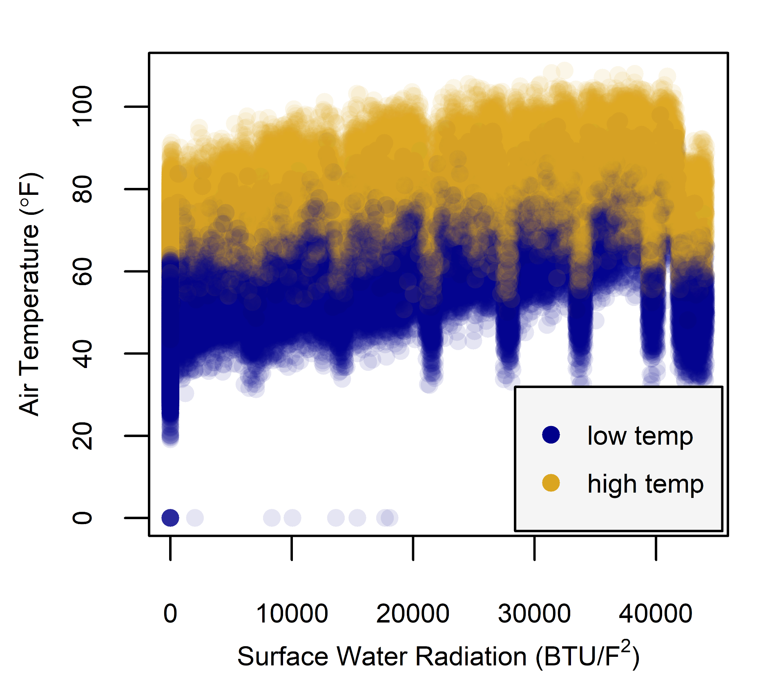
What is machine (!) learning?
Finding the best split in the data.
Best means optimization problem.
Need to define an objective/loss function, decision variables, and constraints.
E.g. tree based methods. Decision trees look at one variable at a time.
?
Notes:
In machine learning, computers apply statistical learning techniques to automatically identify patterns in data.

Slide 5
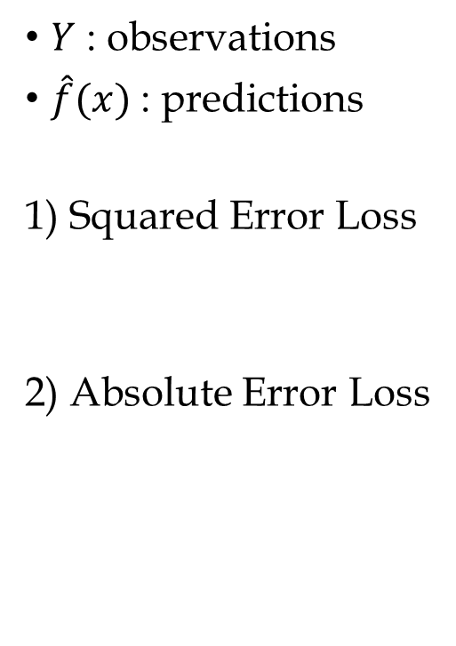
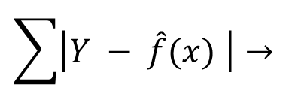
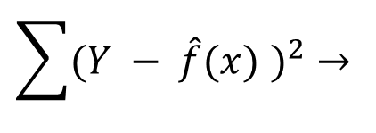
What is the loss function?
$Y$ : observations
$\hat{f}(x)$ : predictions
1) Squared Error Loss
2) Absolute Error Loss
$$\sum{{(Y − \hat{f}(x) )}^{2}}→$$
mean
$$\sum{\left|Y − \hat{f}(x) \right|}→$$
median
Notes:
here are the two most common ones. Especially used in off the shelf methods that can be simply implemented.
Does anyone know if the squared error was our loss functions what statistic the model will be trying to get correct?
And if it’s the absolute error what will the ml method try to get at?

Slide 6
Method
Input Data
- - - - - - - - - - - - - - - - -
Response| Predictor
Missing Data
Fixing Dubious Data
Test
Train
Future Predictions
can be applied to
ML Model
Ungauged Basins
ML Prediction
Measures of Fit
Notes:
We just have to be careful: using statistical models for extrapolation involves some risk and they shouldn’t be strained too much beyond their limits.

Slide 7
Cross-Validation Splitting
Split the data into training set and test set.
Each observation gets to be in the test set at least once.
How big should the folds be? Bias-Variance trade-off.
Report average error estimate of the folds.
Whole dataset
Iteration 1
Iteration 2
Iteration 3
Iteration 4
Iteration 5
Test set
1 fold
Training set
Notes:
Try a few different cross-validation fold sizes. We tried the random 5 fold, and a few different sizes of blocking cross-validation.

Slide 8
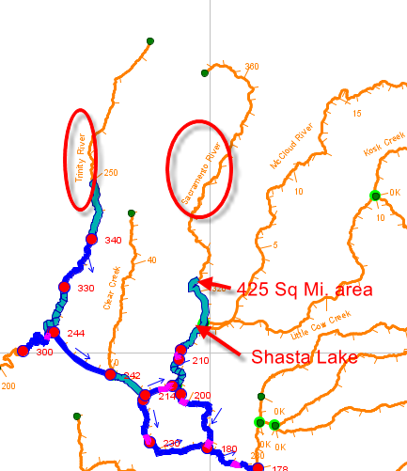
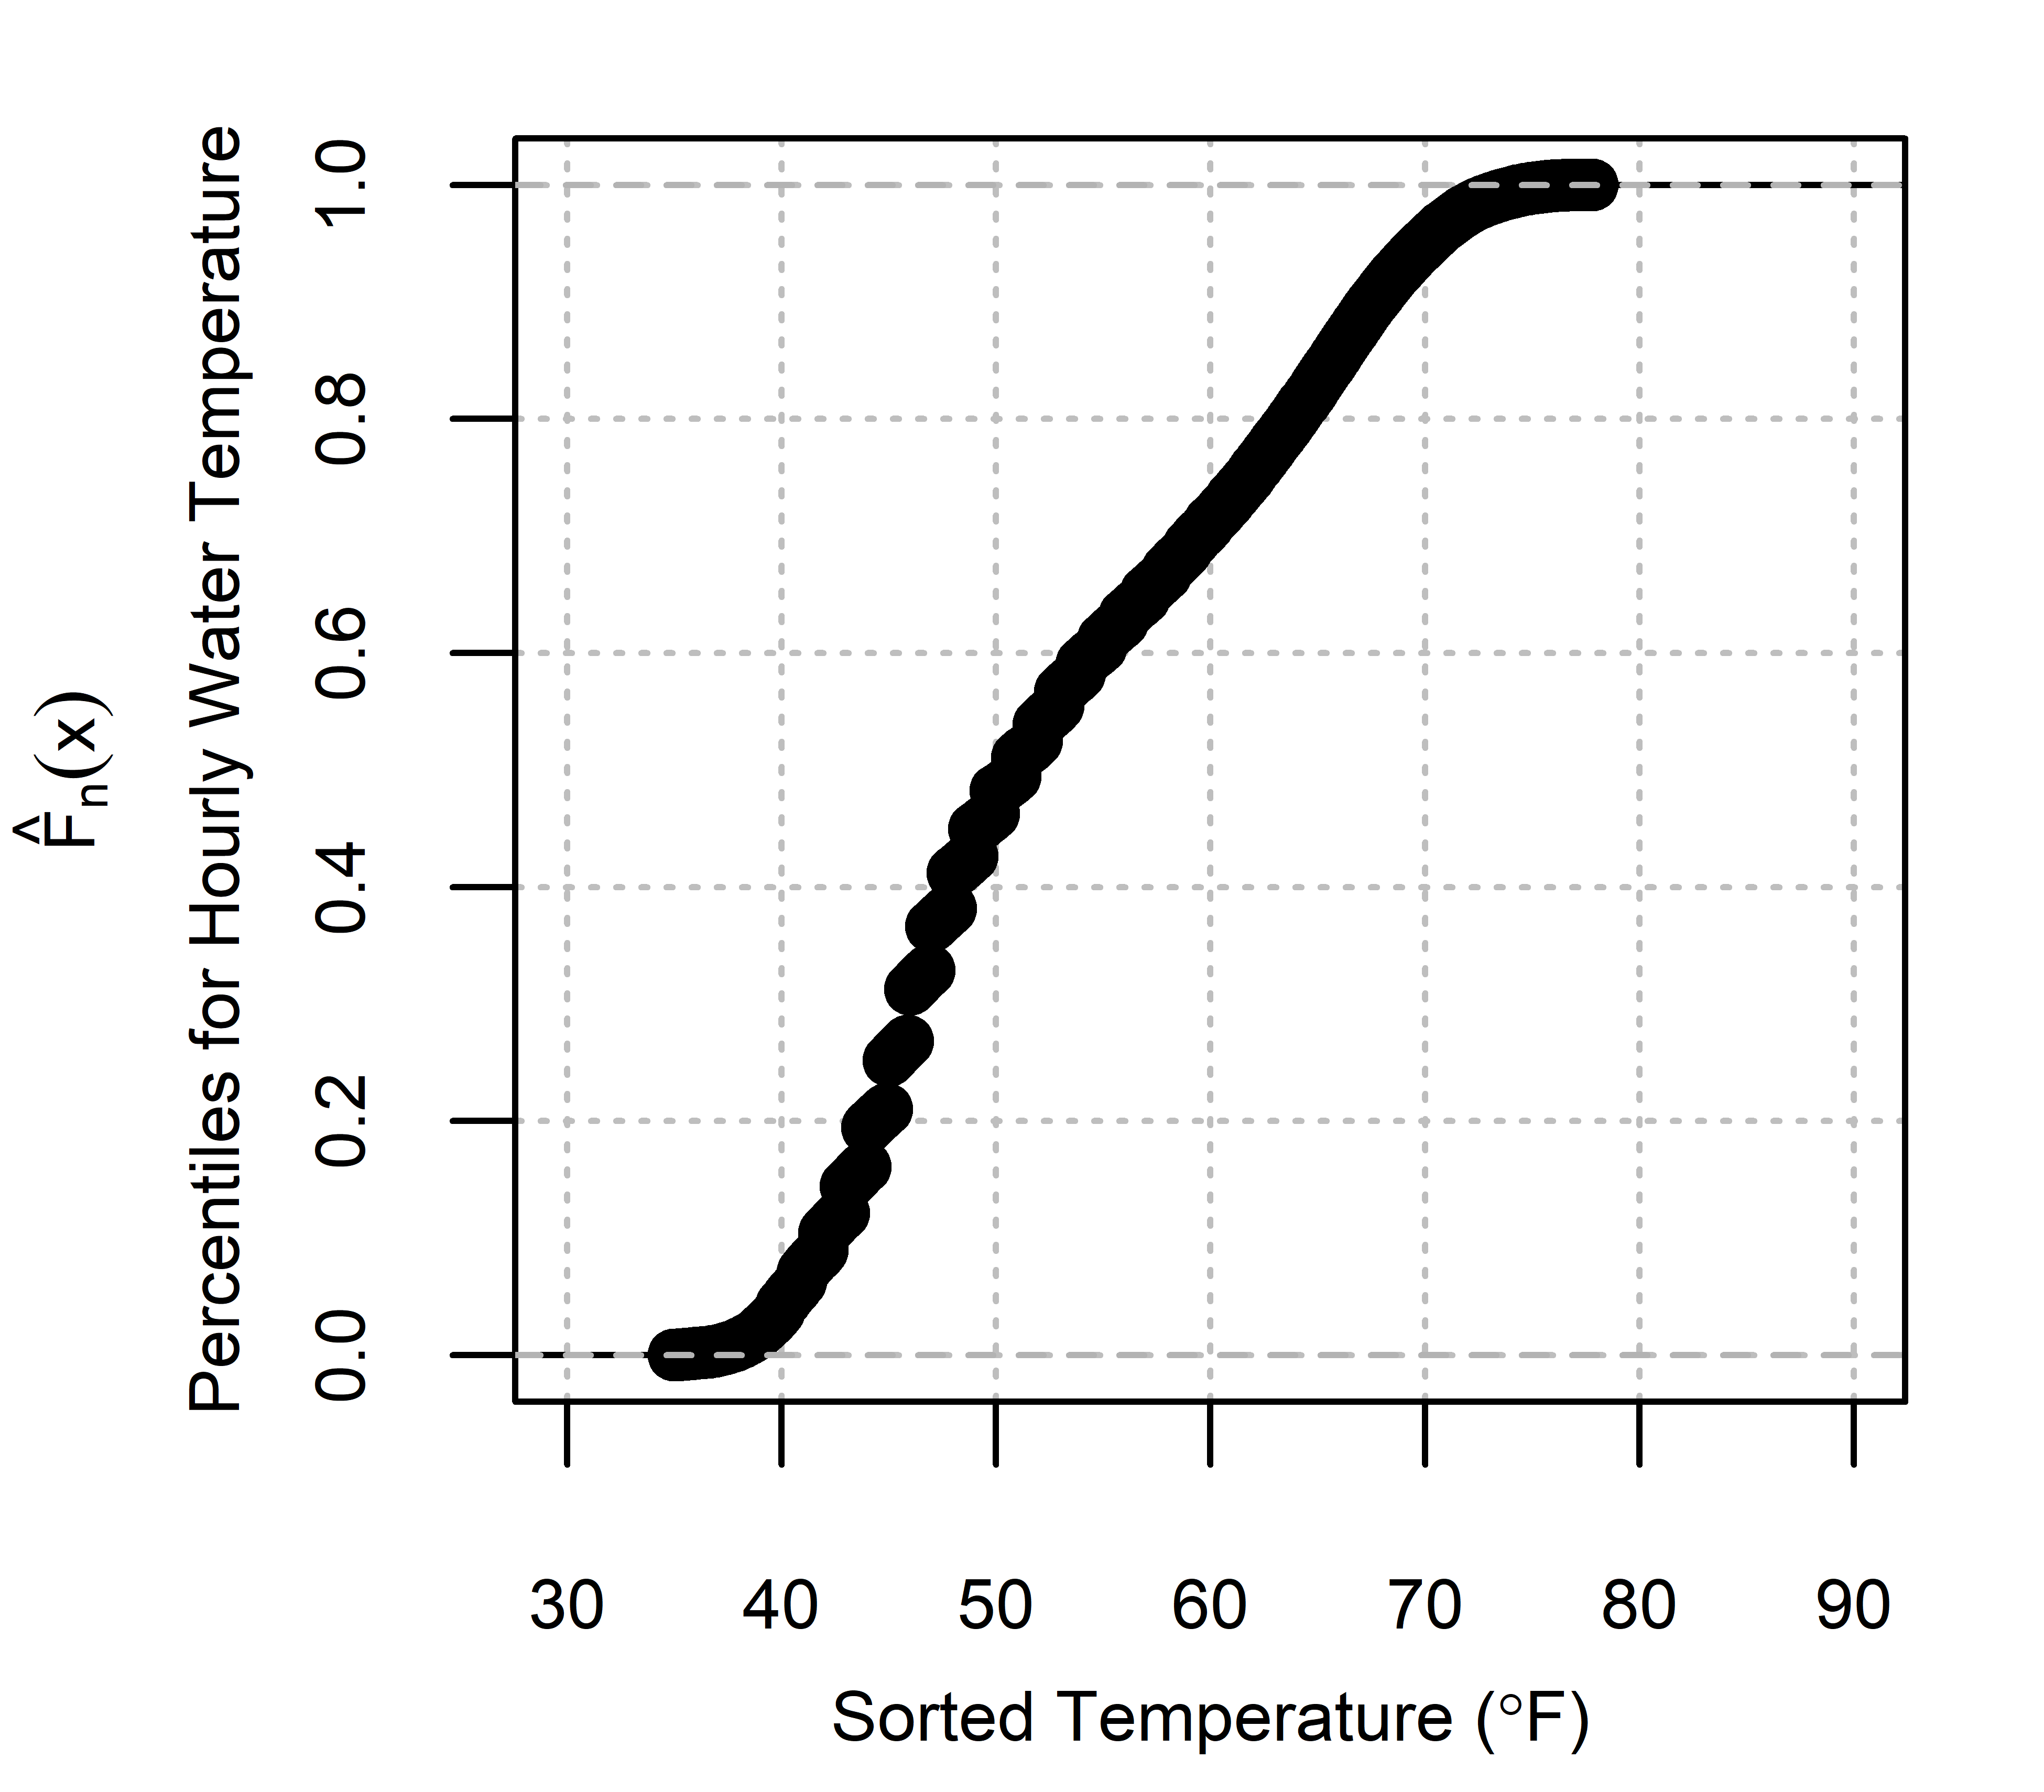
What are we predicting anyway?
Hourly streamflow temperature from California Data Exchange Center (CDEC)
Sacramento River above Shasta Lake
2002-2017
128,097 instances

Slide 9
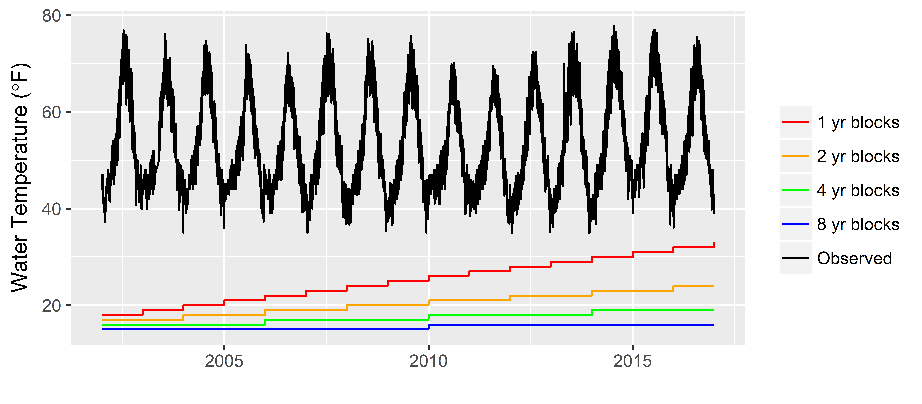
Cross-Validation Splitting
Random
+
Notes:
Explain the blocking, also explain the random that isn’t depicted
Random 5 fold CV, randomly assign the folds to each of the 128,000 observations.
Or use blocking CV, where you have consecutive chunks of data you are leaving out.
I’ll show you later how these CV strategies matter in evaluating your models predictive ability.

Slide 10
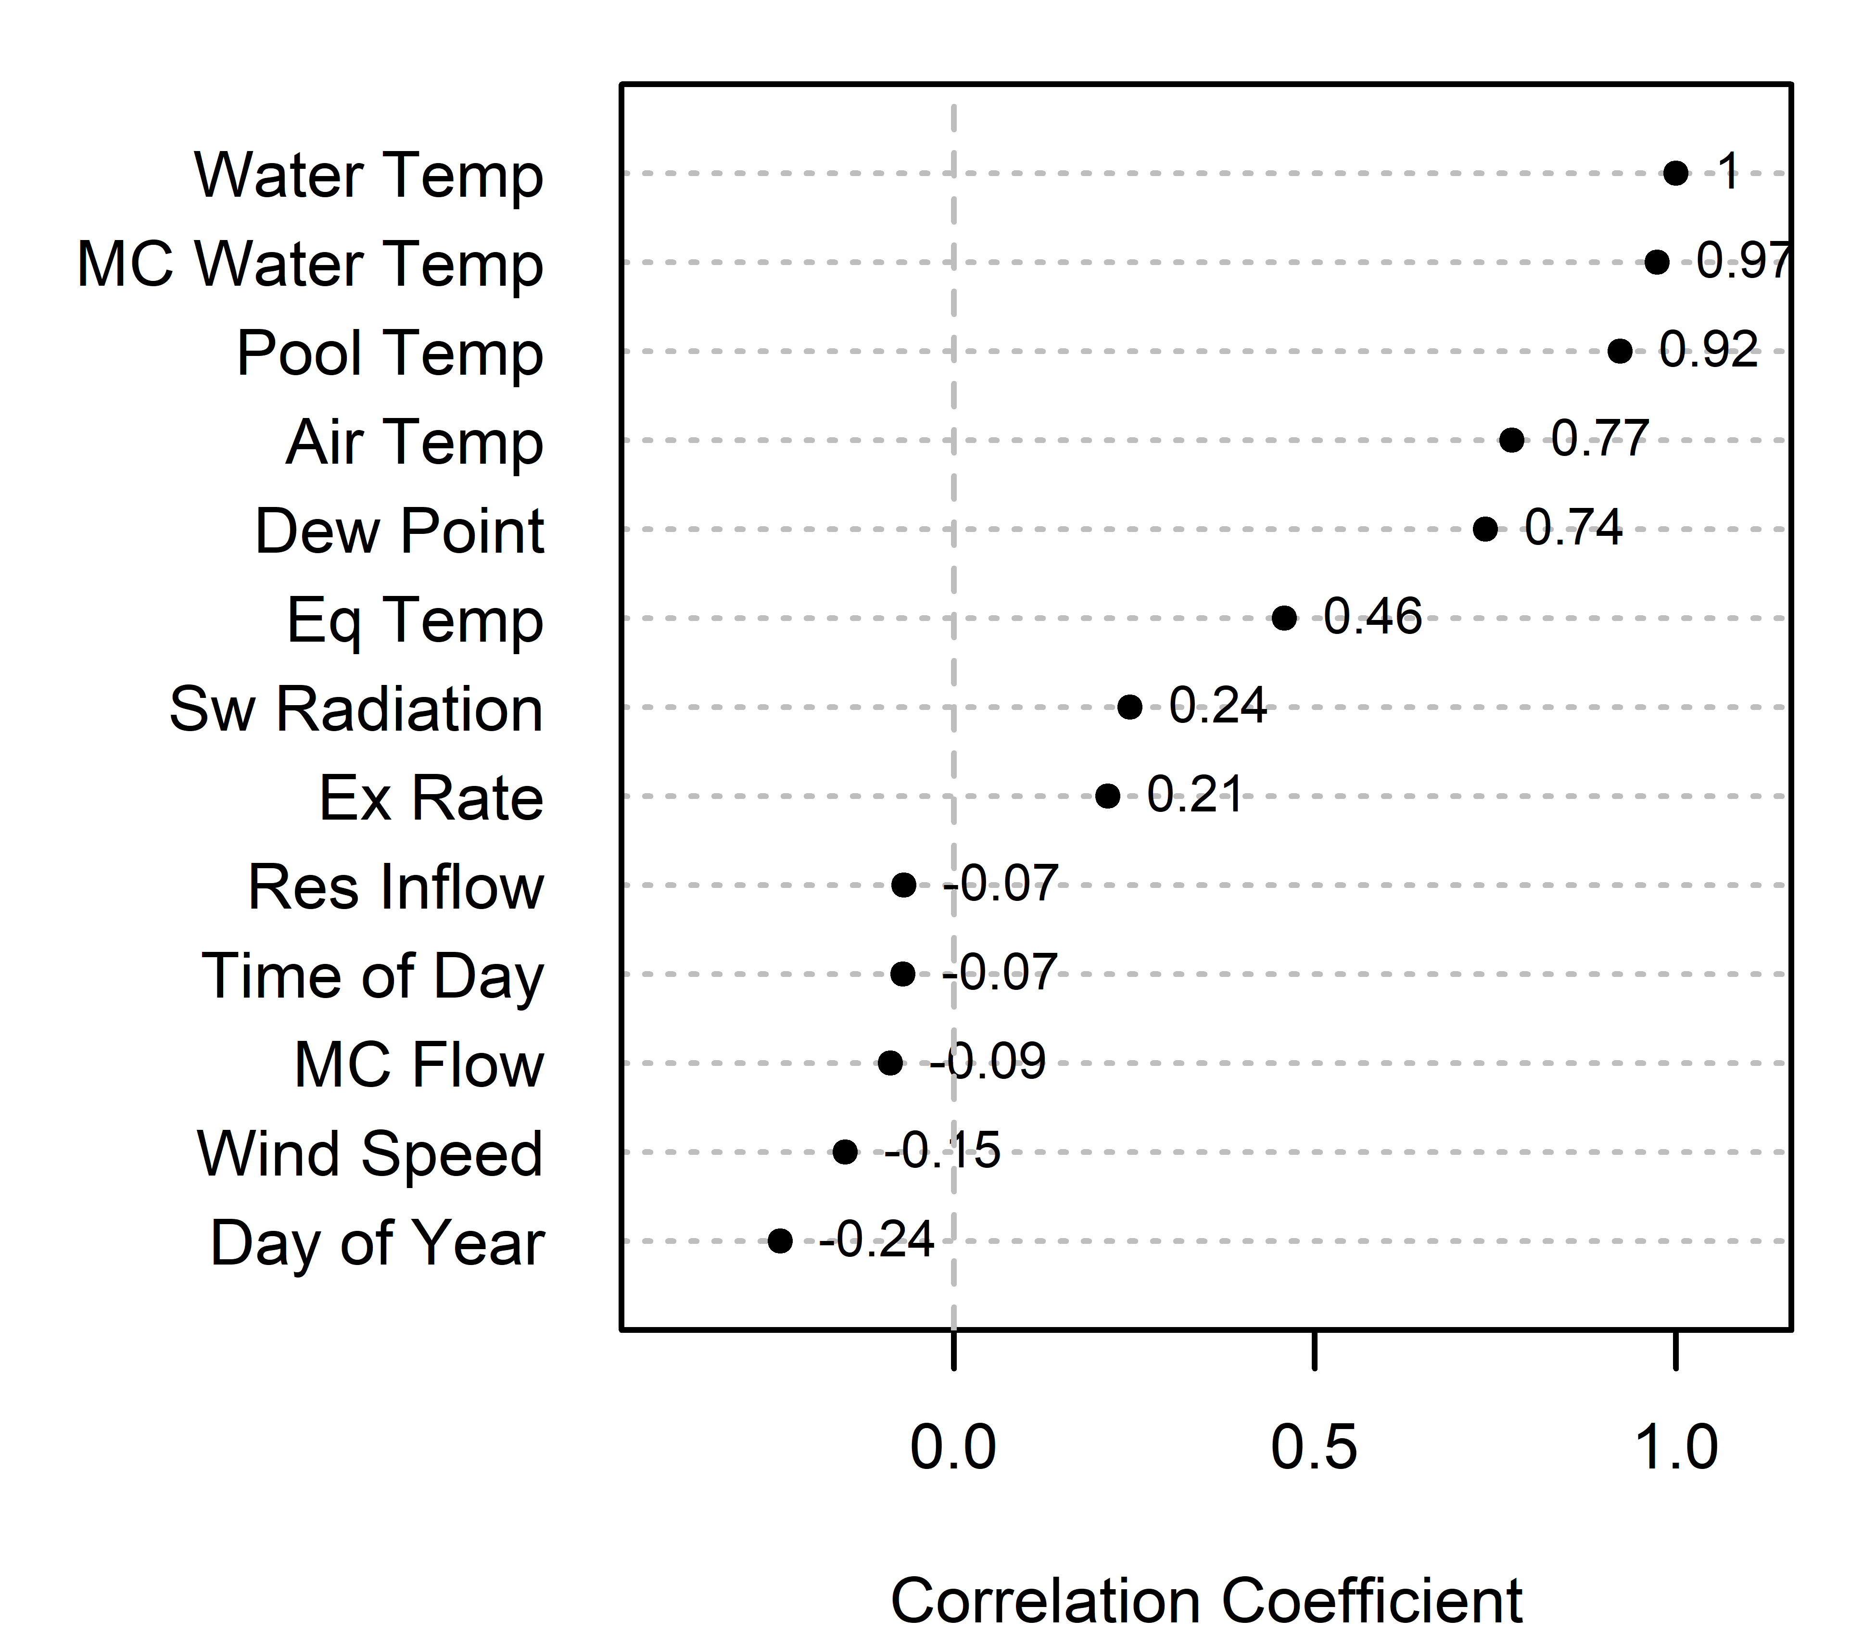
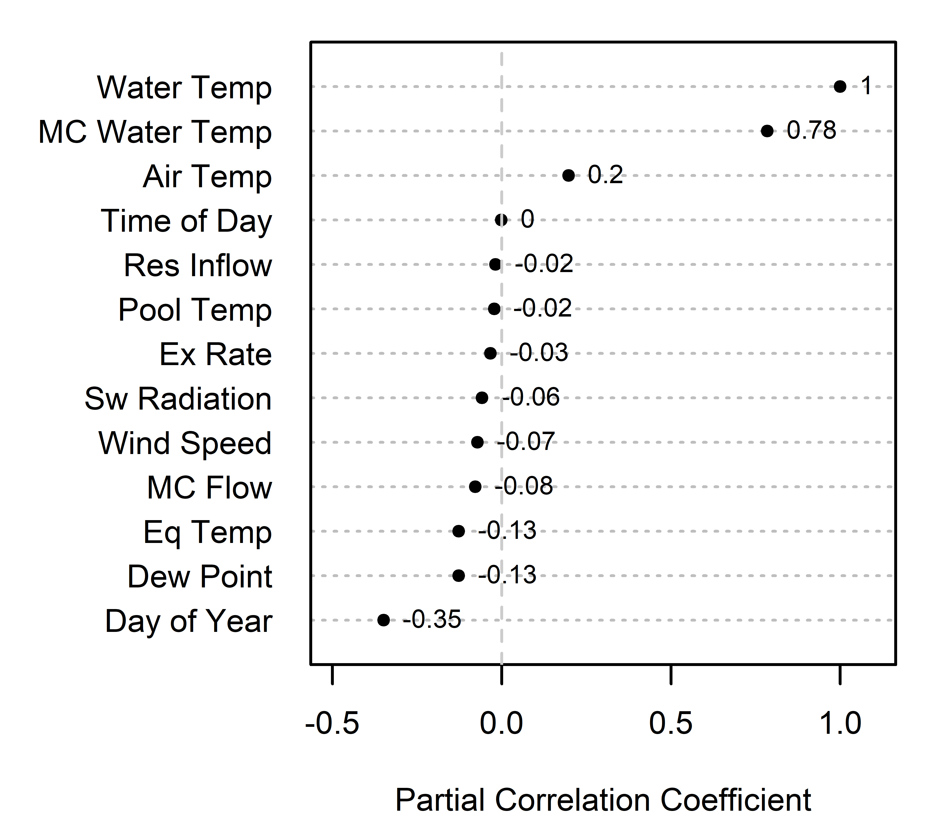
What other data do we have?
McCloud Water Temp
Air Temp
Time of Day: 3pm-hr
Reservoir Inflow
Pool Temp
Exchange Rate
Short Wave Radiation
Wind Speed
McCloud Flow
Equilibrium Temp
Dew Point
Day of Year: 185-JD(1@Jan 1st , 185@July 4th )
Notes:
Plot the correlations and the partial correlations of water temperature to these variables to get a sense of what the data looks like.

Slide 11
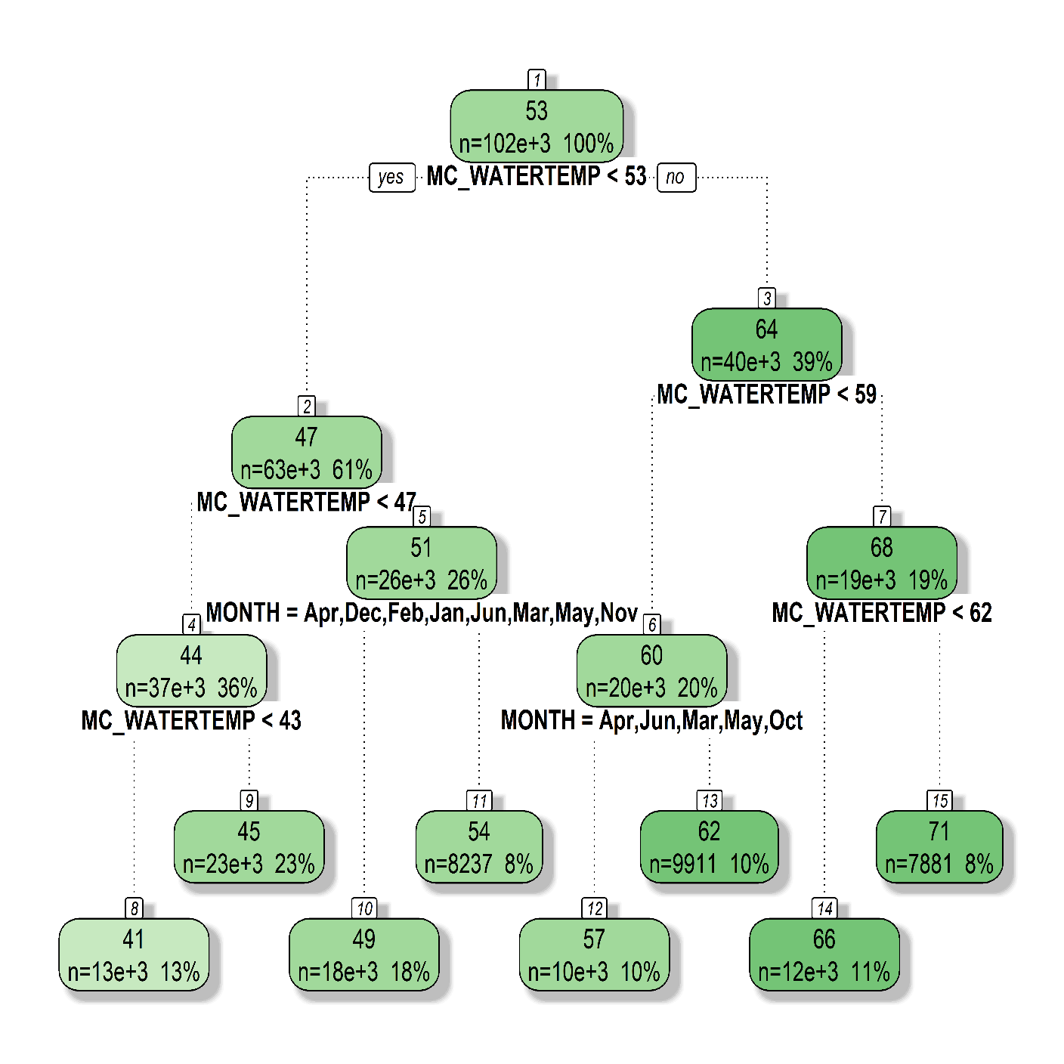
Model: Classification & Regression Tree (CART)
streamflow temperature
prediction
Notes:
Squared error loss function. It is doing a binary split in each of the predictor variables.
CART gives us a nice visualization of the model, but it doesn’t do well on predicting a continuous variable and it is highly sensitive to the data (suffers from high variance). So … we need to fix that.

Slide 12
Model: Random Forest
streamflow temperature
prediction
Notes:
RFs grow a lot of trees, and by injecting randomness in the CART the trees look different.
This allows for the model to grow trees that are uncorrelated. That don’t give the same prediction for the instance of the data you put in so you average them at the end. And the randomness miraculously makes this a better model than each individual tree.

Slide 13
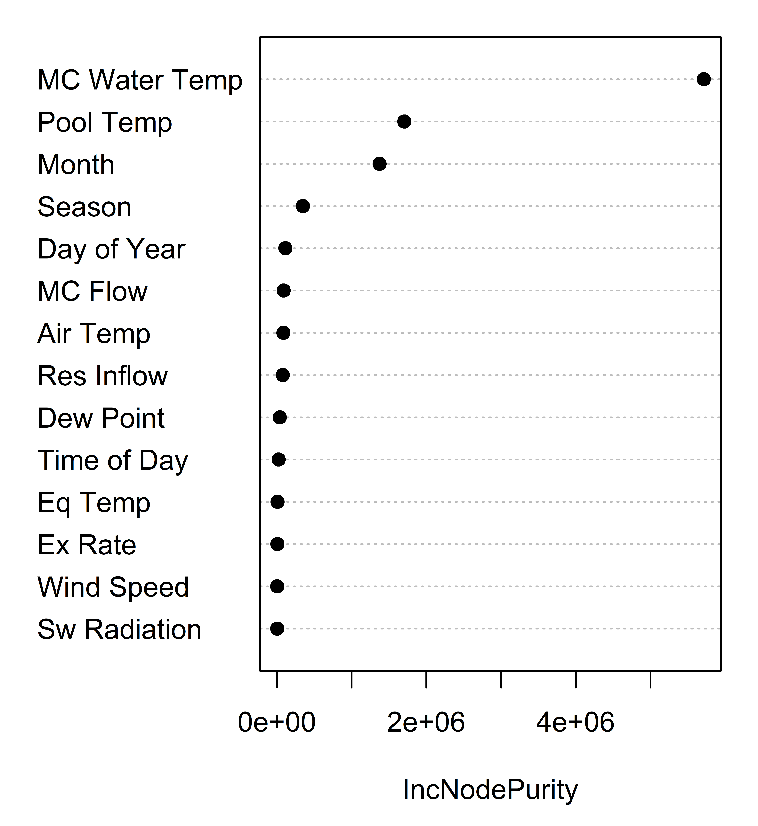
Results: Variable Importance List
Goodness of Split
Notes:
Q2) Which variables are really important?

Slide 14
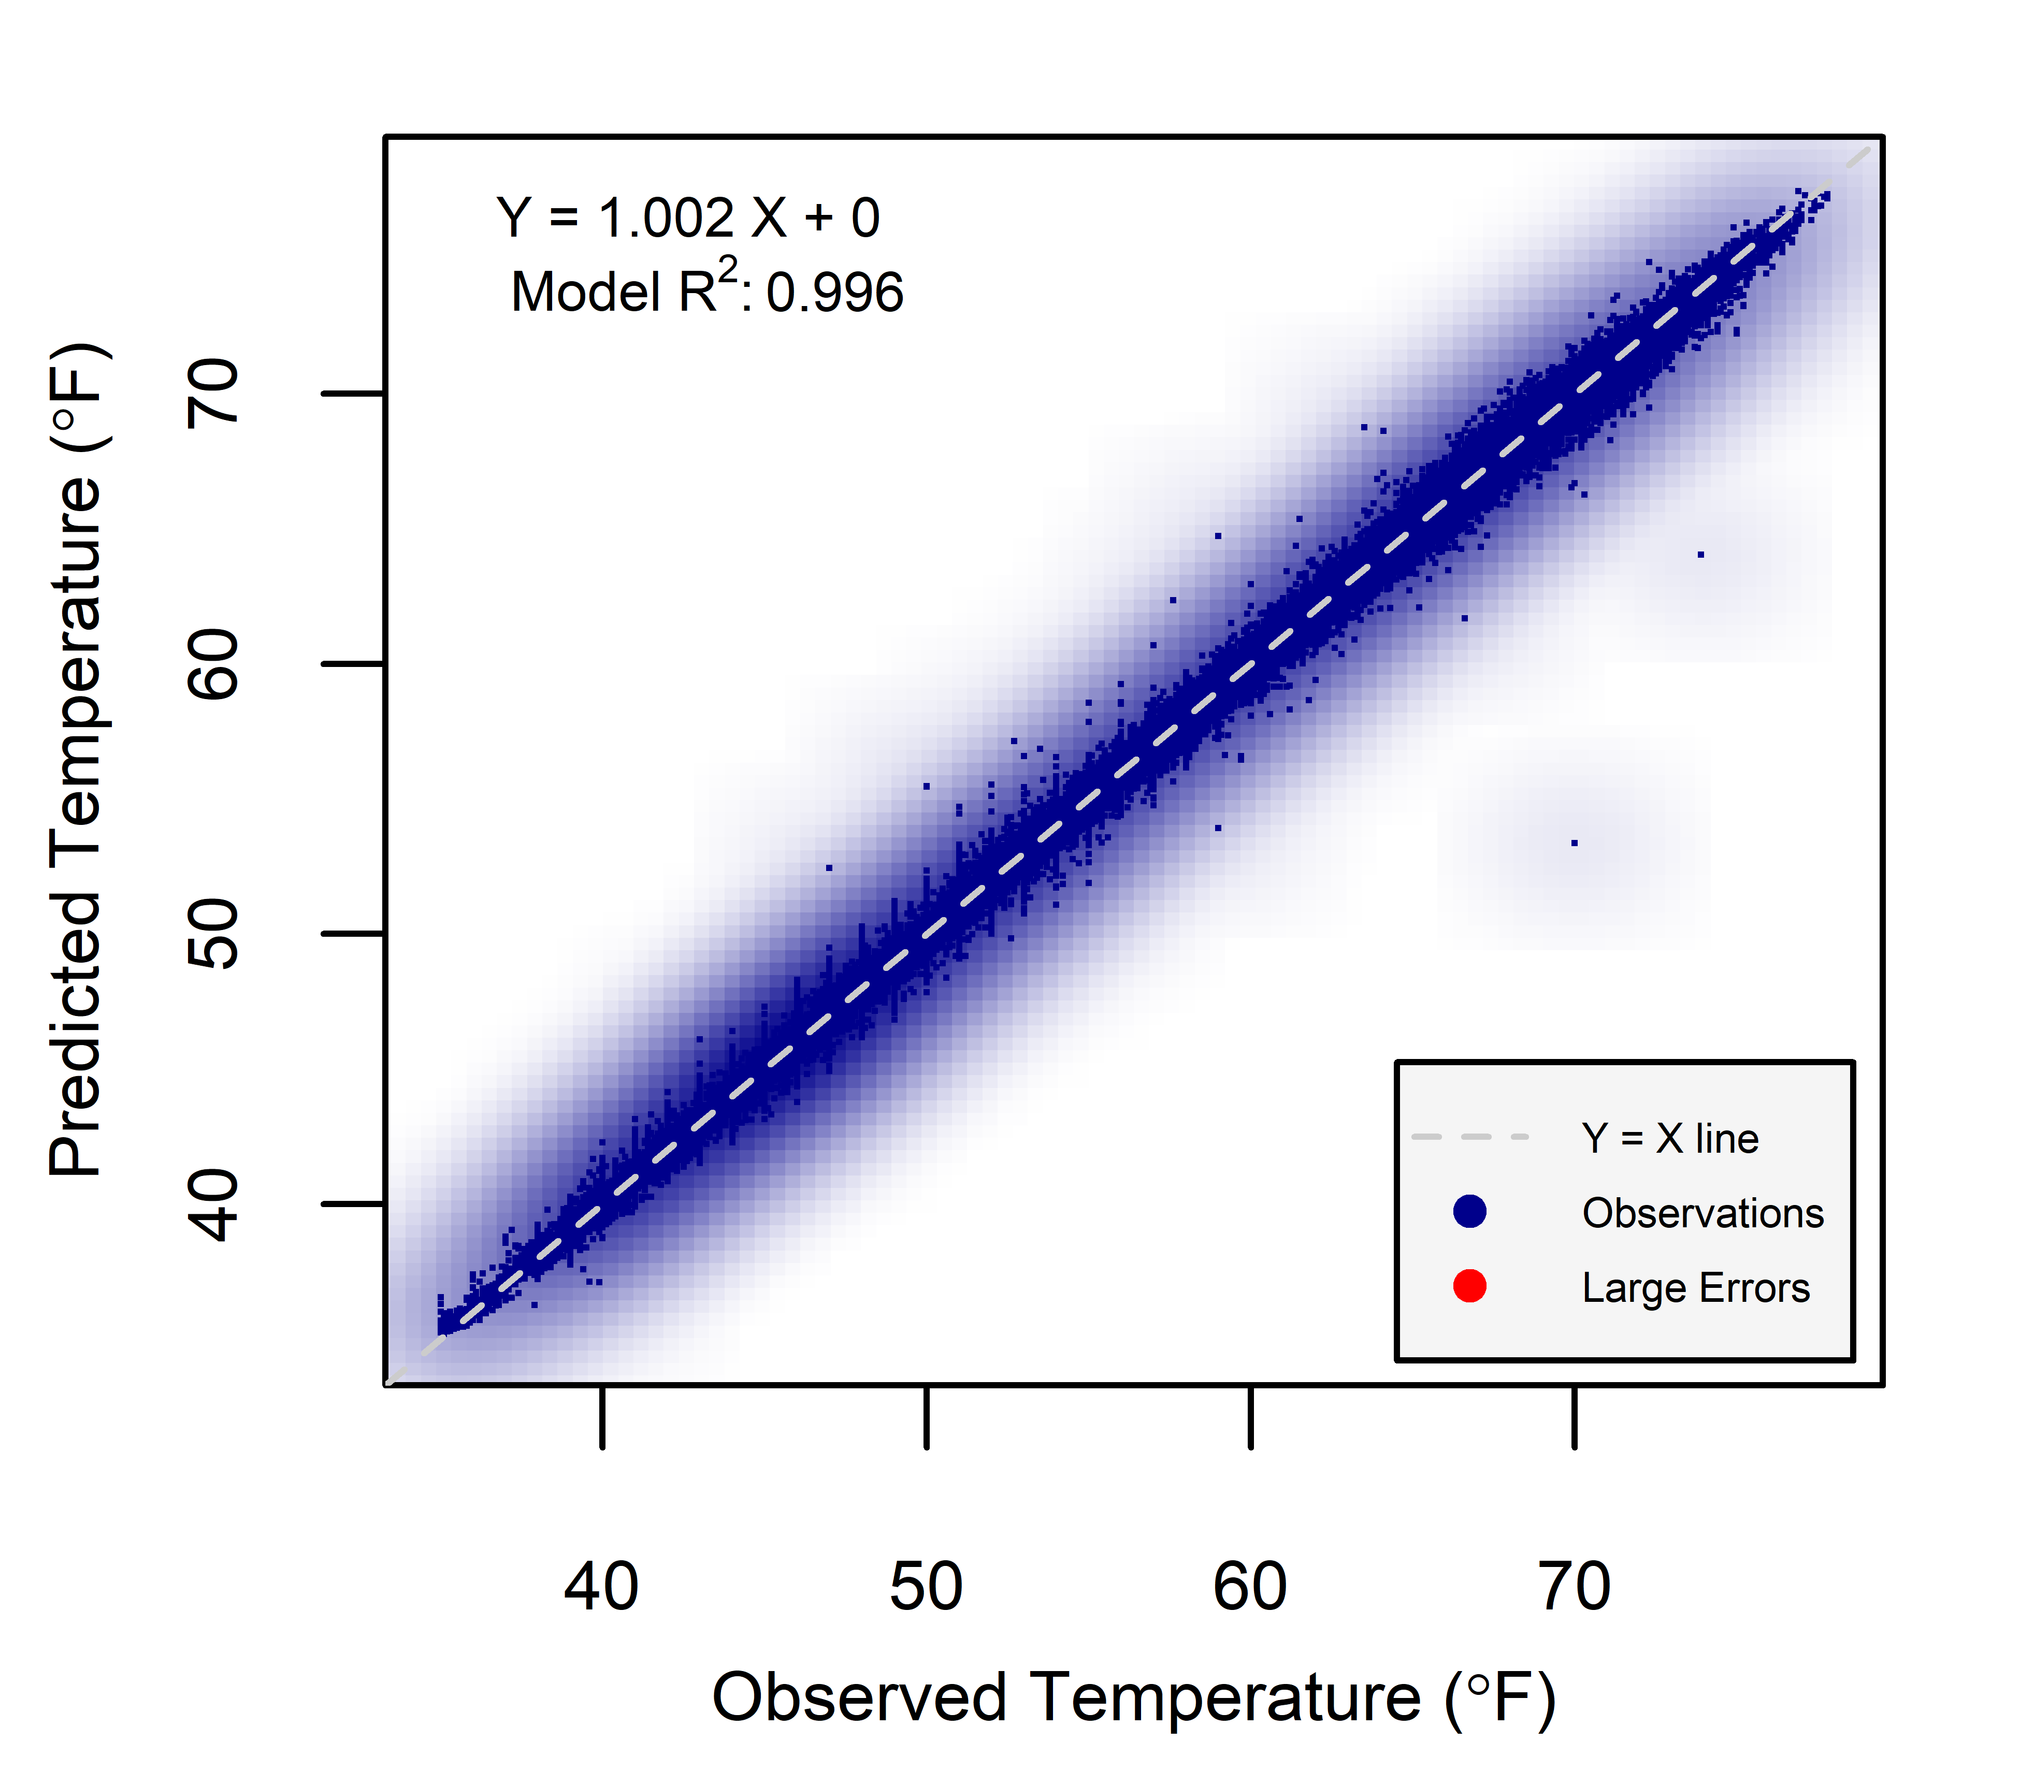
Results: Random CV
Notes:
Q 1) How well can it do?

Slide 15
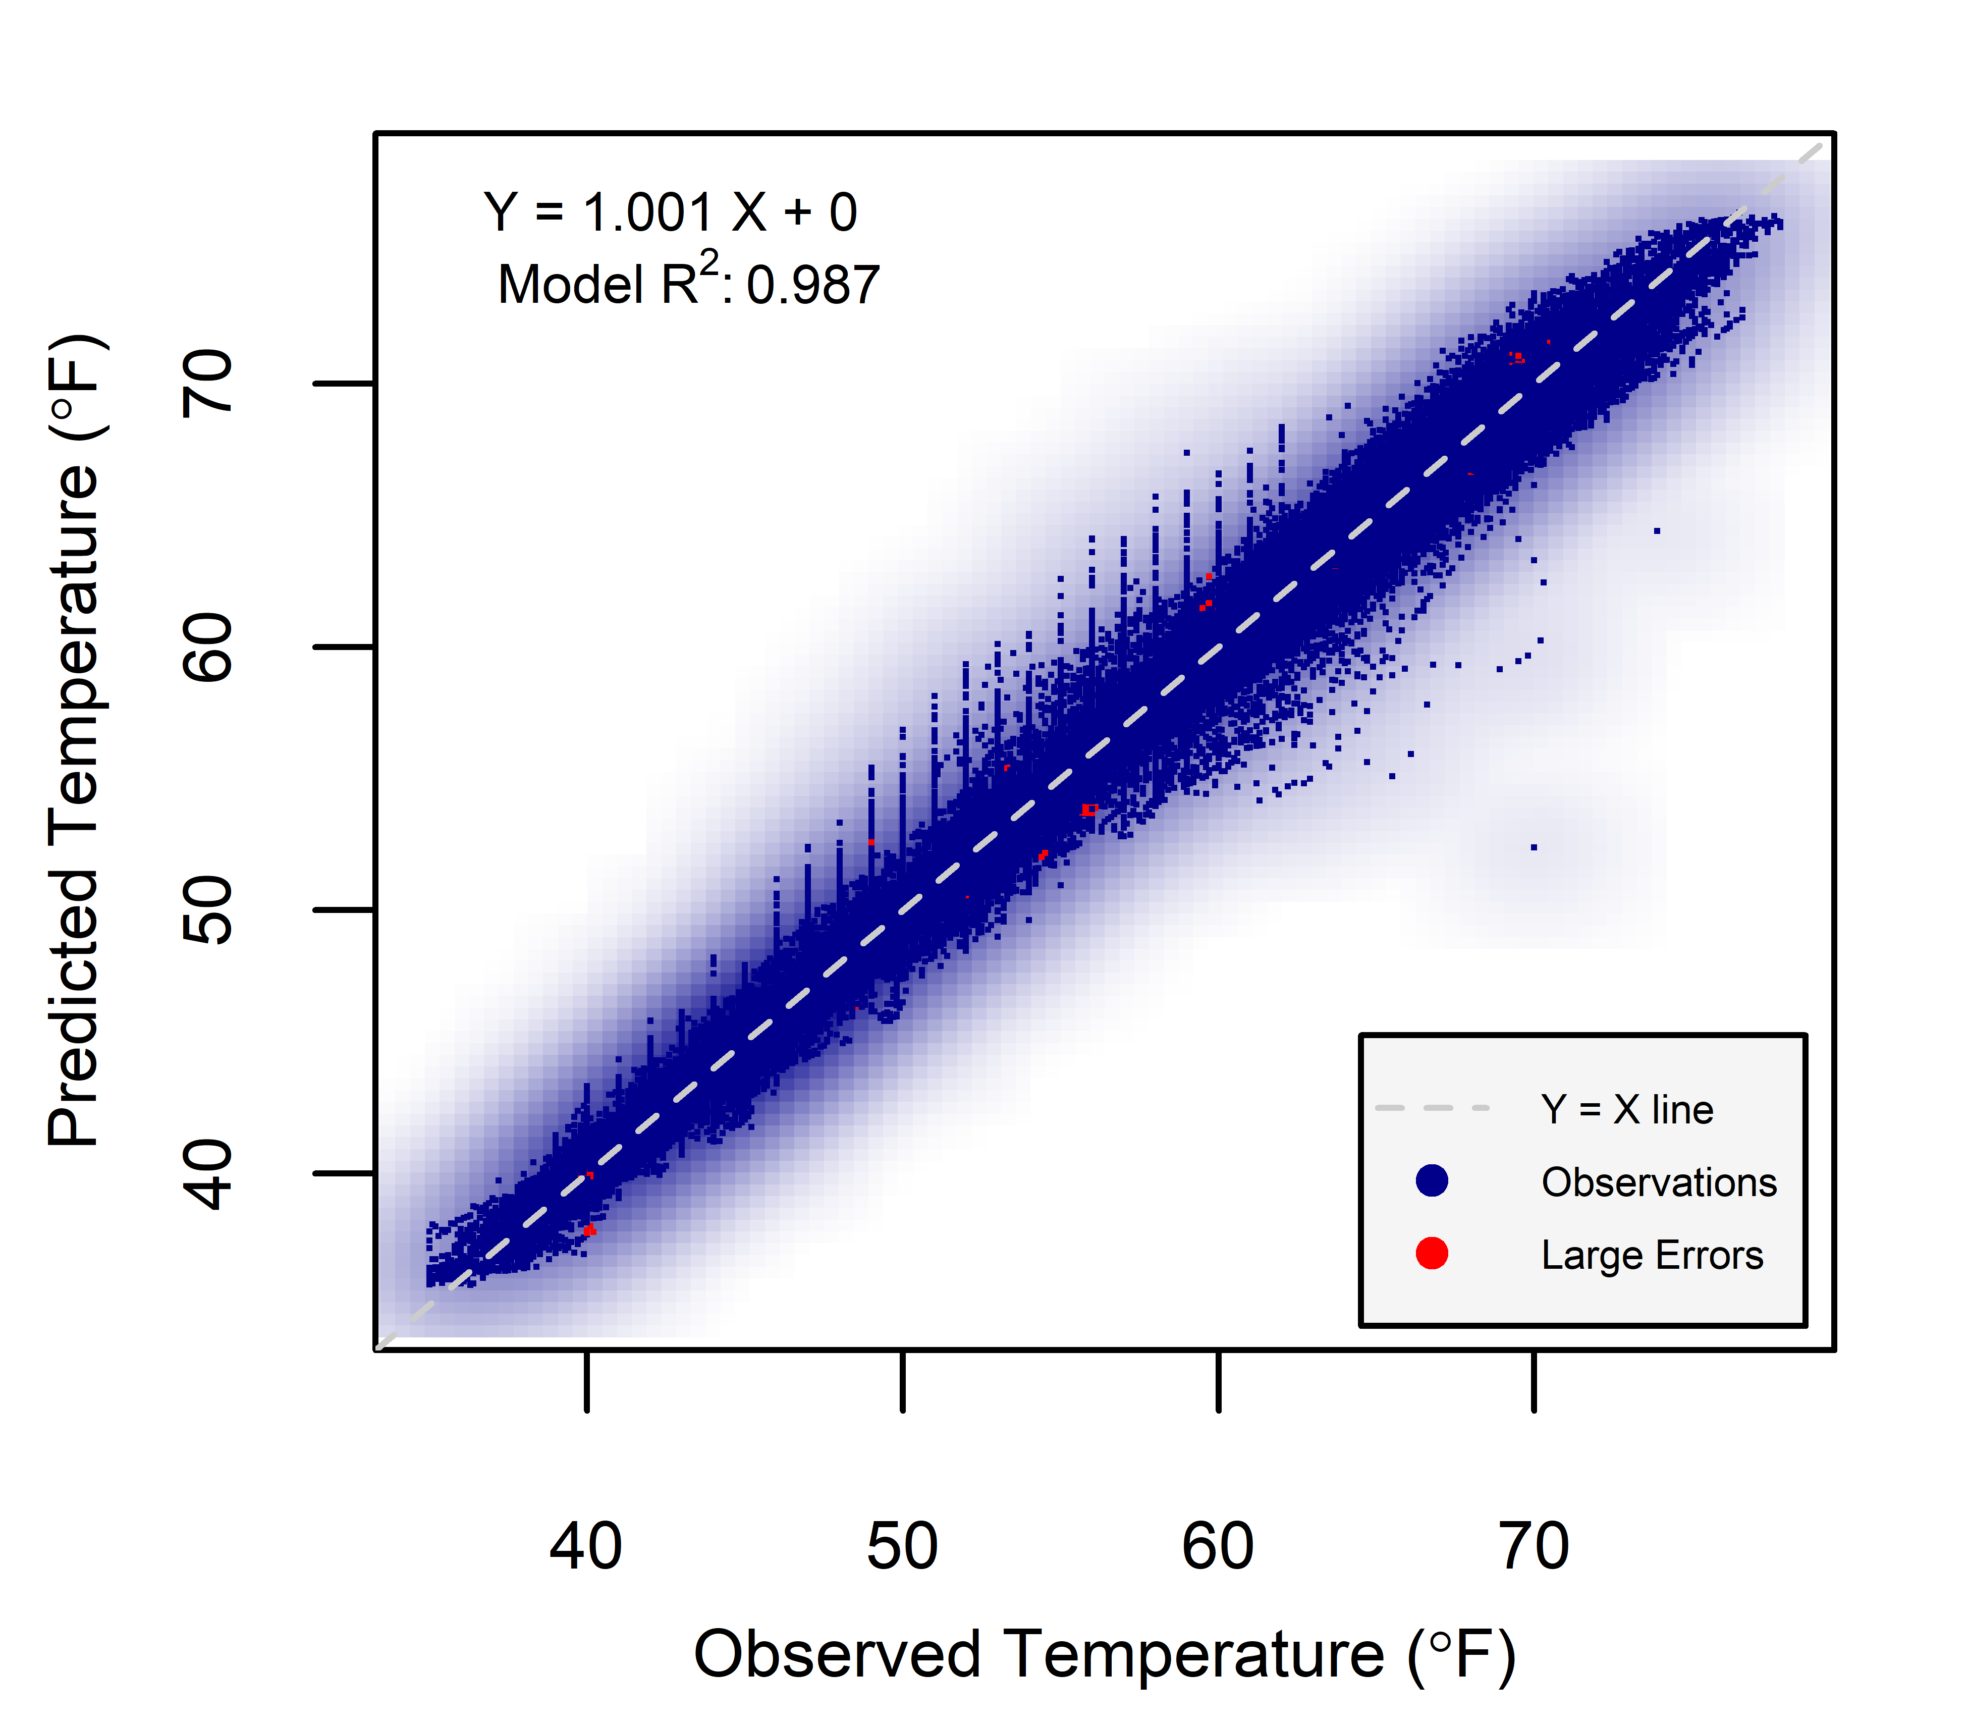
Results: 1 Year Blocking CV

Slide 16

Results: 2 Year Blocking CV

Slide 17
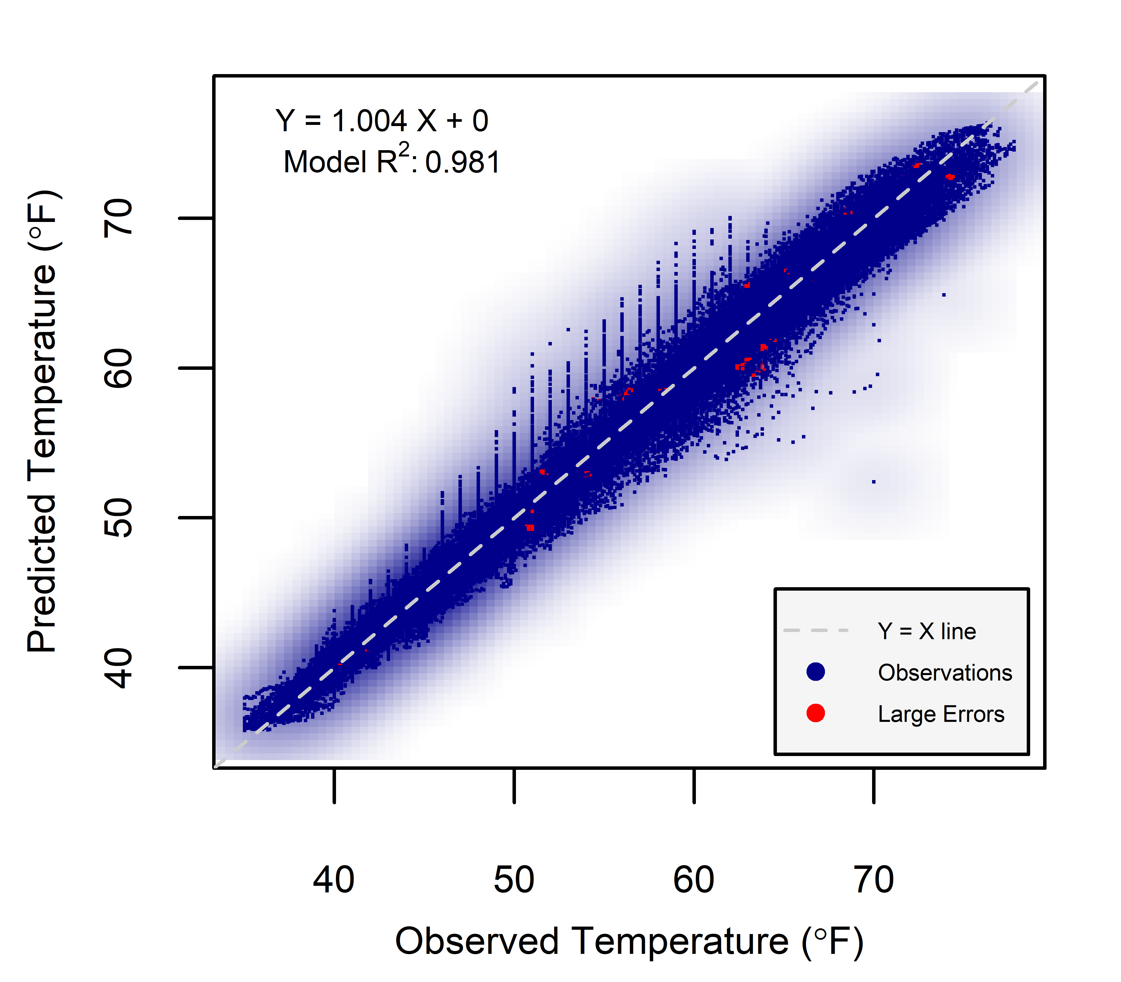
Results: 4 Year Blocking CV

Slide 18
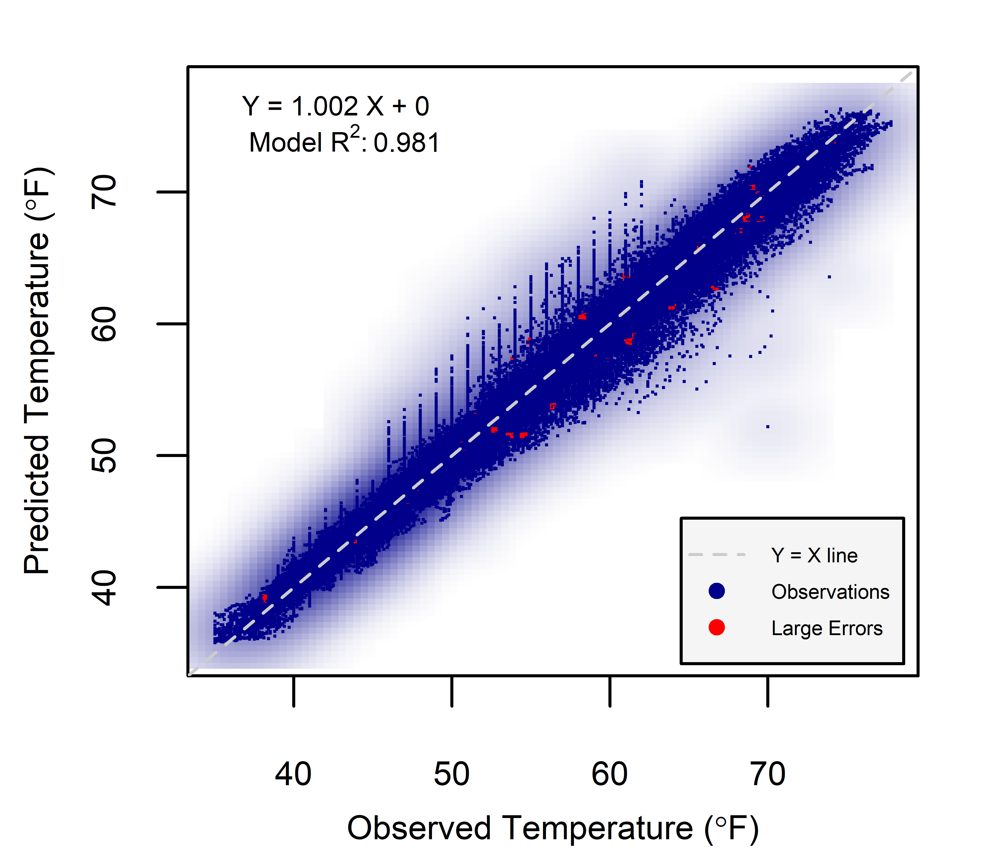
Results: 8 Year Blocking CV

Slide 19
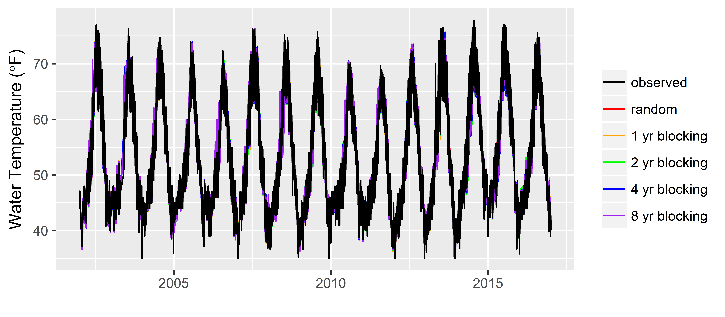
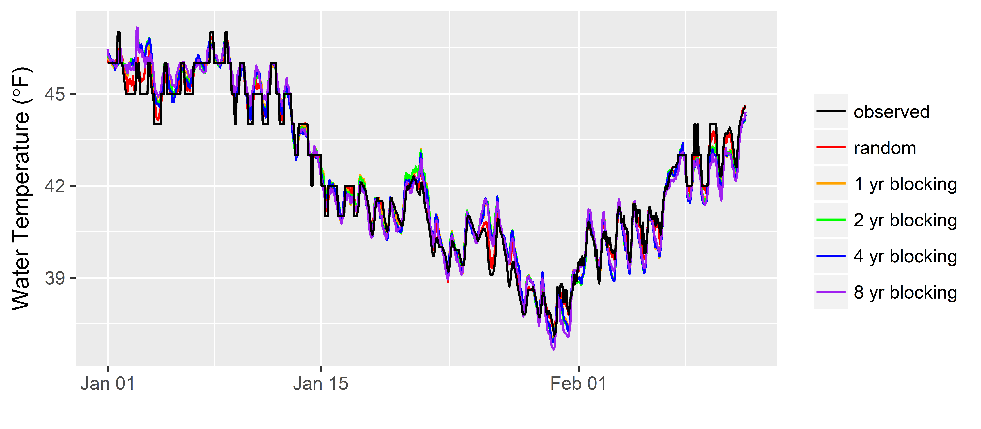
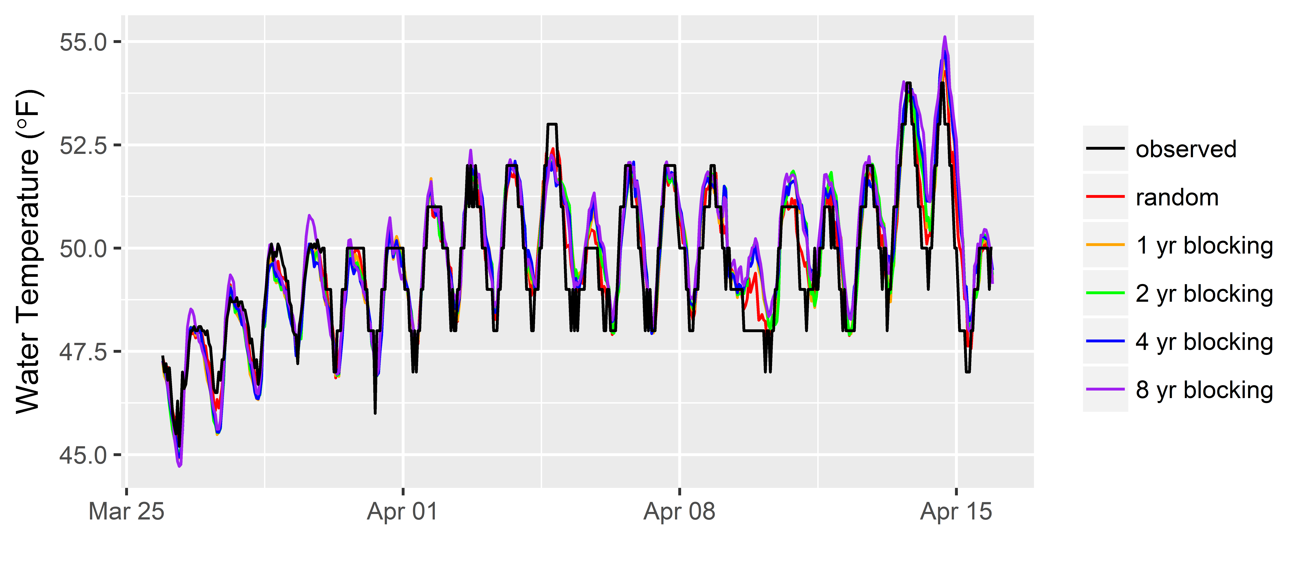
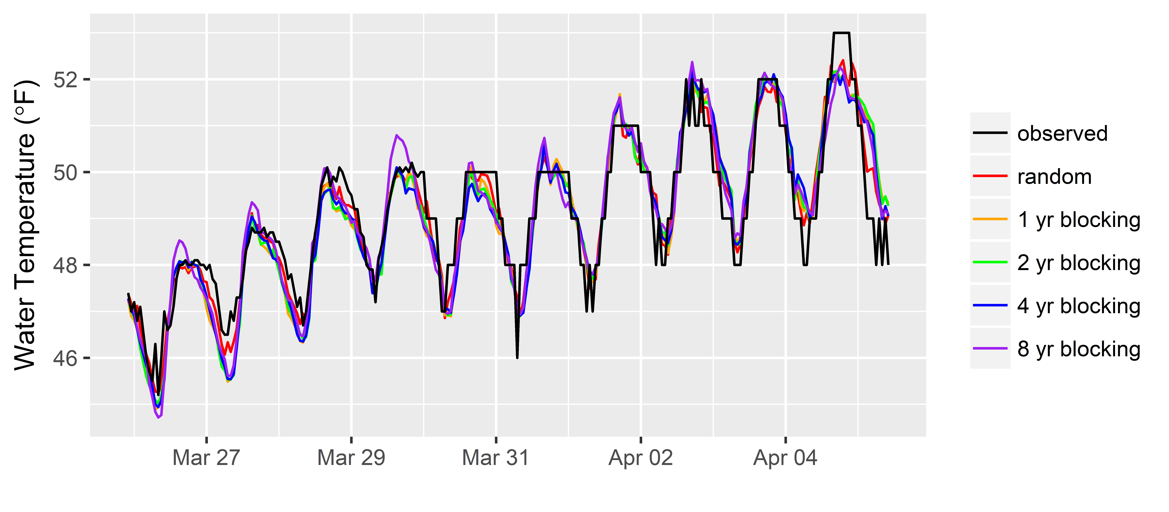
Results: Random Forest
Notes:
Fixes anomalies in the data, steppy thing happening in the observed data as a result of rounding or measurement error.

Slide 20

Next Steps
New data:
Trinity River
Test these predictions against a mechanistic model
Problem of Unguaged Basins
Develop models with other ML methods, and compare
ARIMA
RNN
Change the loss function (?)
by J. J. SEMPÉ
Notes:
If it does bad on Trinity, then need to change this to an ungauged basin problem, where training comes from a lot of different basins.
If we are trying to predict the extremes accurately then we will have to use a different loss function.

Slide 21

Conclusions
“[predictive modeling] is not a substitute for intuition, but rather a complement” ~Ayres, 2007 in Super Crunchers: Why Thinking–By–Numbers Is The New Way To Be Smart
Have to mind the correlation in the data
Don’t just do random cross-validation!!!
Use blocking methods
Have to mind the loss function
by J. J. SEMPÉ
Notes:
Neither data-driven models nor the expert relying solely on intuition will do better than a combination of the two. ~Kuhn & Johnson, 2013
Humans usually make better predictions when they are provided with the results of statistical prediction.” ~Ayres, 2007
Have to mind the loss function, especially if you are trying to get the extremes right. You cannot use off the shelf methods for this unless they allow you to modify the loss function manually.

Slide 22
Citations
R Core Team (2017). R: A language and environment for statistical computing. R Foundation for Statistical Computing, Vienna, Austria. URL https://www.R-project.org/ . R version 3.4.0 (2017-04-21) -- "You Stupid Darkness"
Taiyun Wei and Viliam Simko (2016). corrplot: Visualization of a Correlation Matrix. R package version 0.77. https://CRAN.R-project.org/package=corrplot
Pebesma, E.J., R.S. Bivand, 2005. Classes and methods for spatial data in R. R News 5 (2), https://cran.r-project.org/doc/Rnews/ .
Roger S. Bivand, Edzer Pebesma, Virgilio Gomez-Rubio, 2013. Applied spatial data analysis with R, Second edition. Springer, NY. http://www.asdar-book.org/
Terry Therneau, Beth Atkinson and Brian Ripley (2017). rpart: Recursive Partitioning and Regression Trees. R package version 4.1-11. https://CRAN.R-project.org/package=rpart
A. Liaw and M. Wiener (2002). Classification and Regression by randomForest. R News 2(3), 18--22.
Robert J. Hijmans (2016). raster: Geographic Data Analysis and Modeling. R package version 2.5-8. https://CRAN.R-project.org/package=raster
Roger Bivand and Colin Rundel (2017). rgeos: Interface to Geometry Engine - Open Source (GEOS). R package version 0.3-23. https://CRAN.R-project.org/package=rgeos
Roger Bivand, Tim Keitt and Barry Rowlingson (2017). rgdal: Bindings for the Geospatial Data Abstraction Library. R package version 1.2-7. https://CRAN.R-project.org/package=rgdal
Edmund M. Hart and Kendon Bell (2015) prism: Download data from the Oregon prism project. R package version 0.0.6 http://github.com/ropensci/prism DOI: 10.5281/zenodo.33663
USDA-NRCS Soil Survey Staff (2016). sharpshootR: A Soil Survey Toolkit. R package version 1.0. https://CRAN.R-project.org/package=sharpshootR
Hadley Wickham (2007). Reshaping Data with the reshape Package. Journal of Statistical Software, 21(12), 1-20. URL http://www.jstatsoft.org/v21/i12/ .
Nathaniel W. Chaney, Eric F. Wood, Alexander B. McBratney, Jonathan W. Hempel, Travis W. Nauman, Colby W. Brungard, Nathan P. Odgers, POLARIS: A 30-meter probabilistic soil series map of the contiguous United States, Geoderma, Volume 274, 15 July 2016, Pages 54-67, ISSN 0016-7061, https://doi.org/10.1016/j.geoderma.2016.03.025.
Flint, L. E., Flint, A. L., Thorne, J. H., & Boynton, R. (2013). Fine-scale hydrologic modeling for regional landscape applications: the California Basin Characterization Model development and performance. Ecological Processes, 2(1), 25. https://ecologicalprocesses.springeropen.com/articles/10.1186/2192-1709-2-25

Slide 23

Questions?
by A. GETZ

Slide 24

Relevant(?!) xkcd
Goodness of Split
Notes:
Doing that will more than likely not help the performance of the model. What makes the data speak is the process. adding noise features that are not truly associated with the response will lead to a deterioration in the fitted model, and consequently an increased test set error. This is because noise features increase the dimensionality of the problem, exacerbating the risk of having trees in the forest that do not make splits on the variables we know better describe flow.
"Subject-specific knowledge can help separate potentially meaningful information from irrelevant information, eliminating detrimental noise and strengthening the underlying signal.“ ~Kuhn & Johnson, 2013

Slide 25
CART: Tree Size

Slide 26
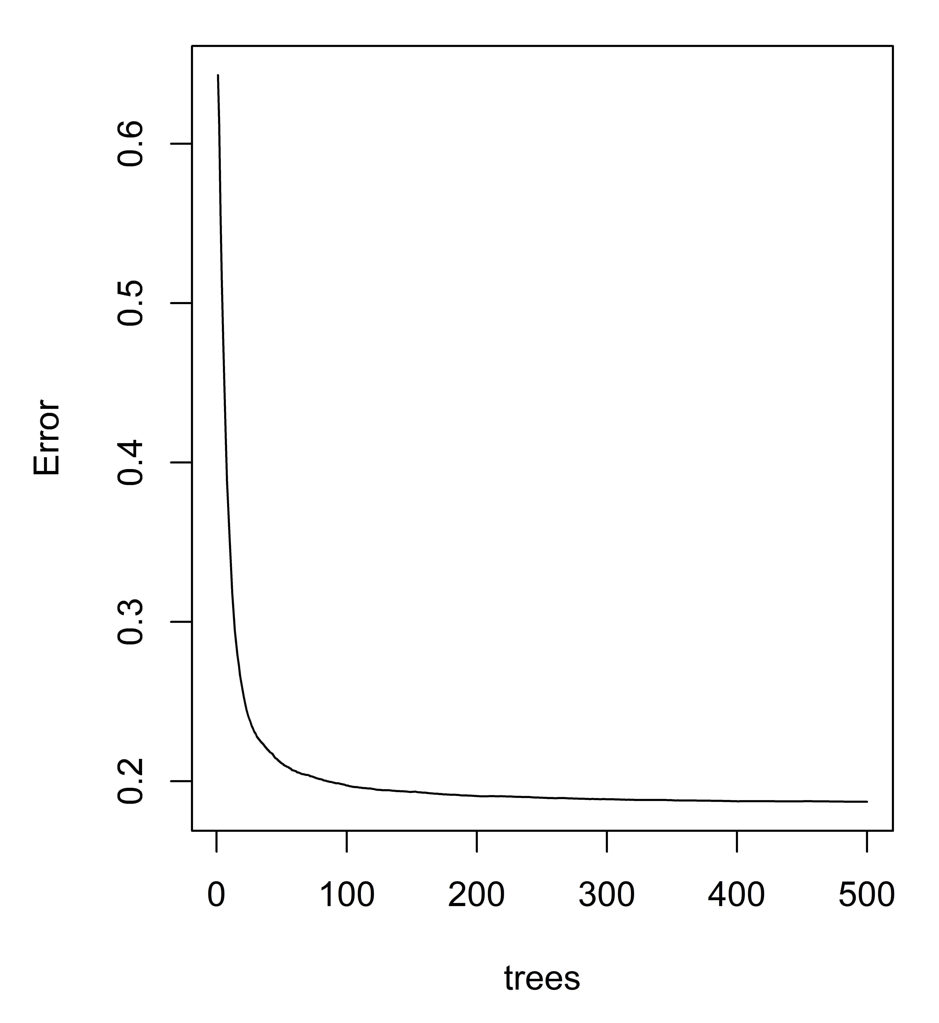
Results: Random Forest

Slide 27
Results: Model Fit
R2
RMSE
NSE
RSR
PBIAS

Slide 28
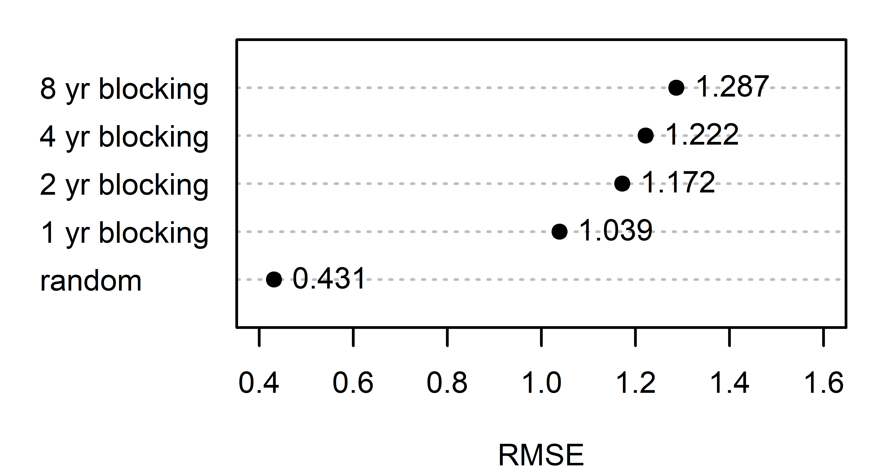
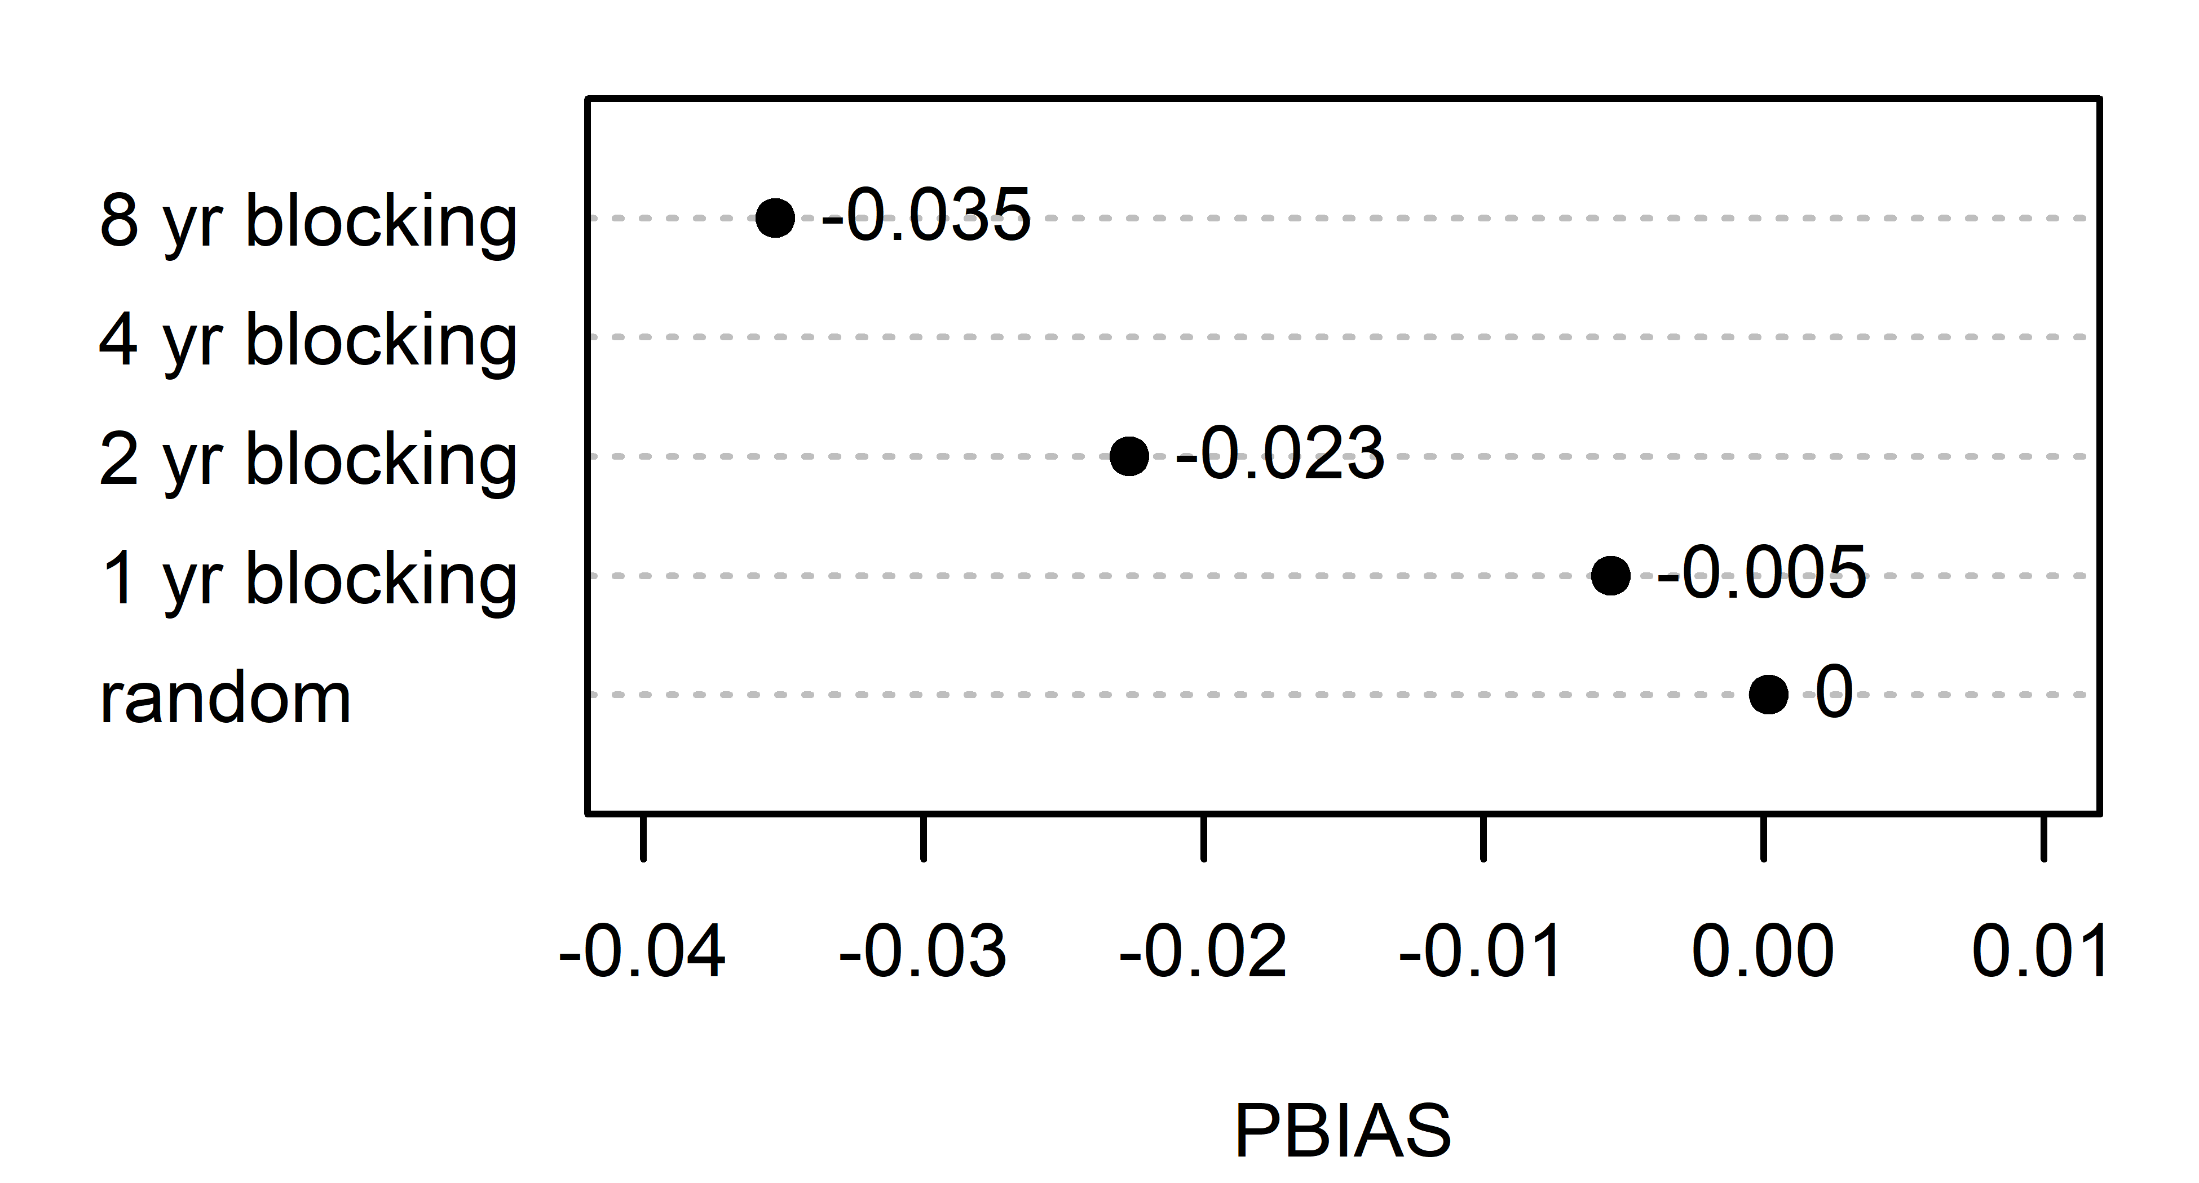
Results: Model Measures of Fit

